Slide 2
Today
Verbs & Nouns (Actions and Objects)
10:10 - Attendance
10:20 - On-in-at
10:45 - See the homework
Break: 10:55-11:05
11:05 – Do the actions
11:15 – Practice: IN, ON & AT
11:30 – Work in Groups of 4-5
After 12:00 – Write sentences

Slide 3
Actions

Slide 4
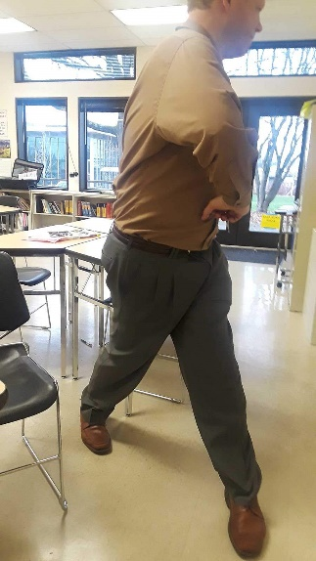
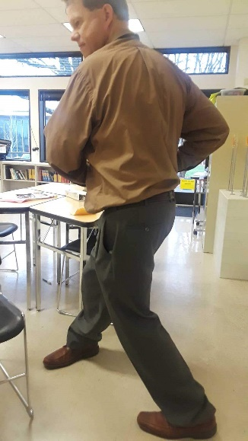

Slide 5
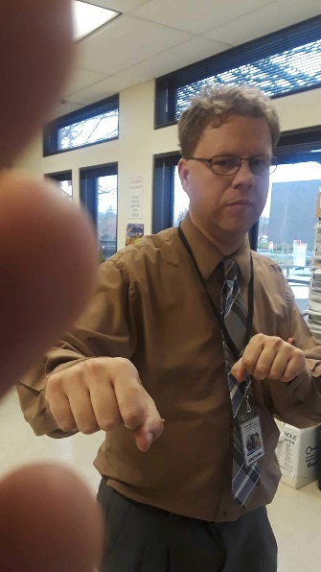

Slide 6
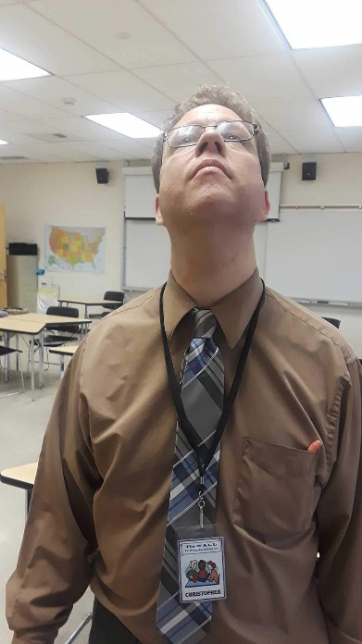
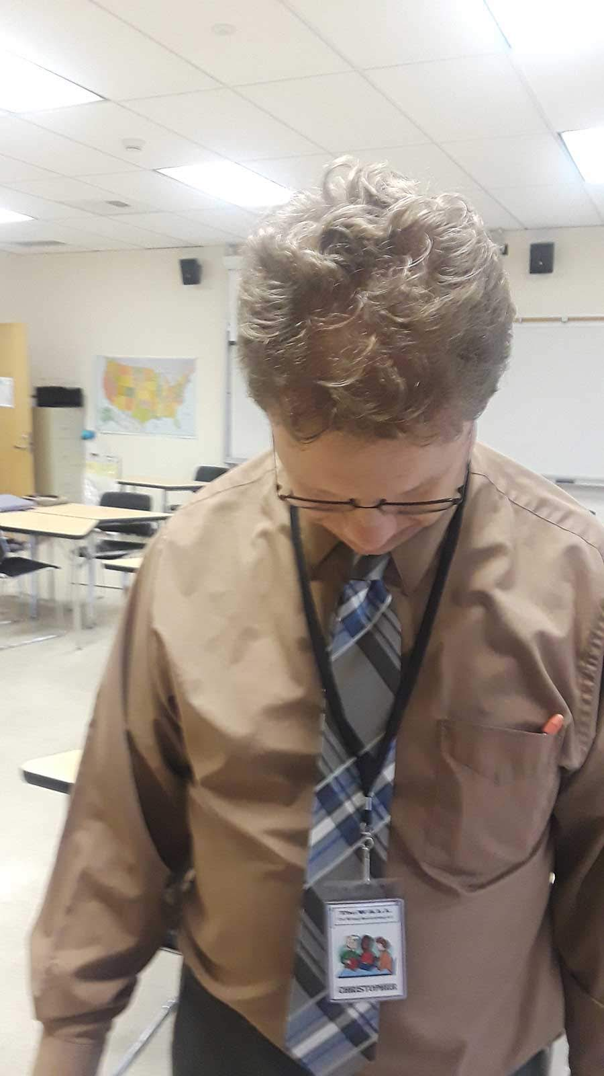

Slide 7
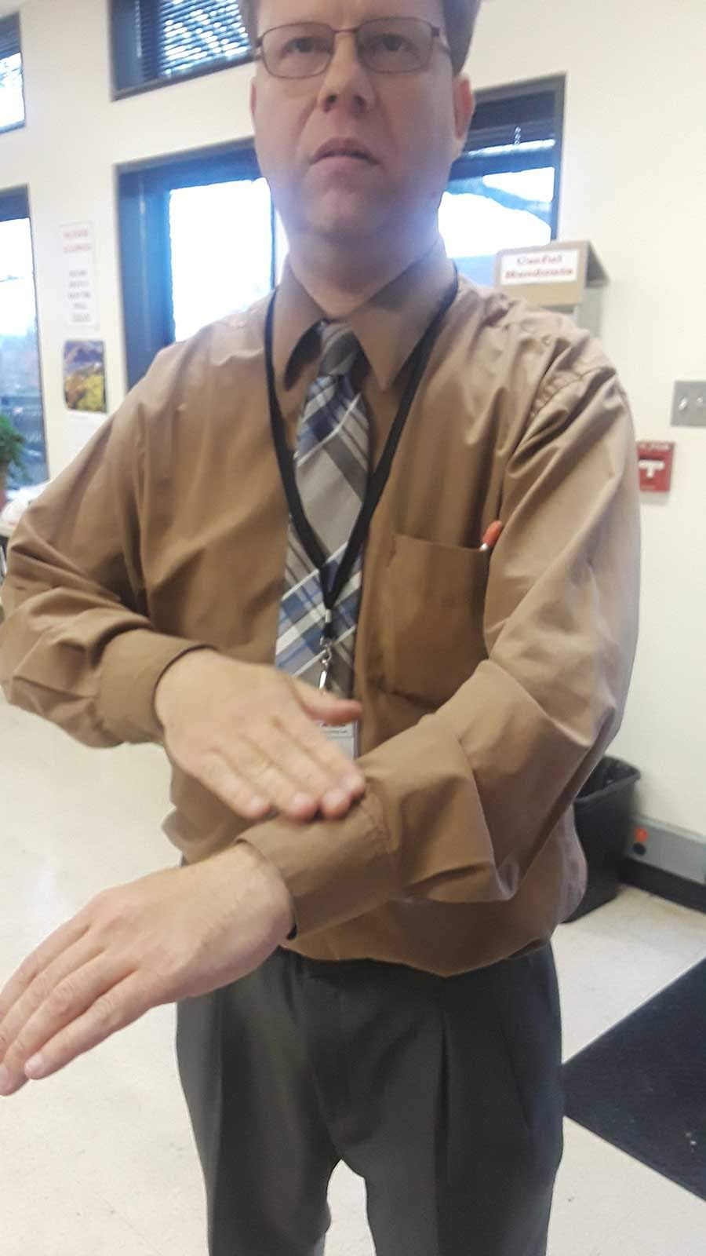

Slide 8
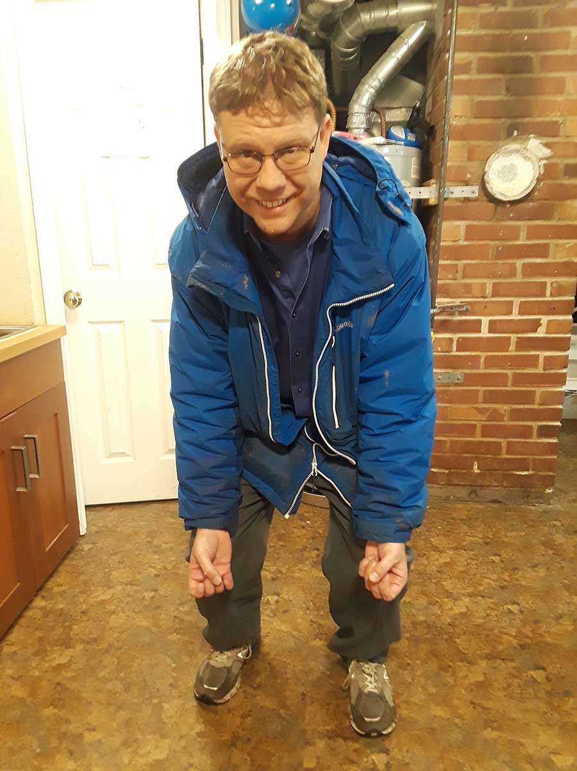
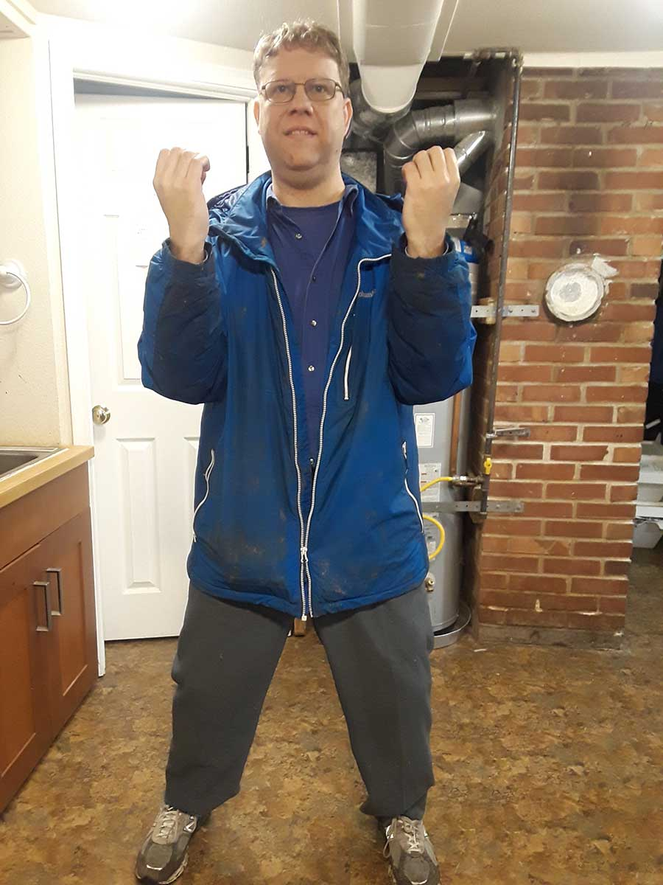

Slide 9
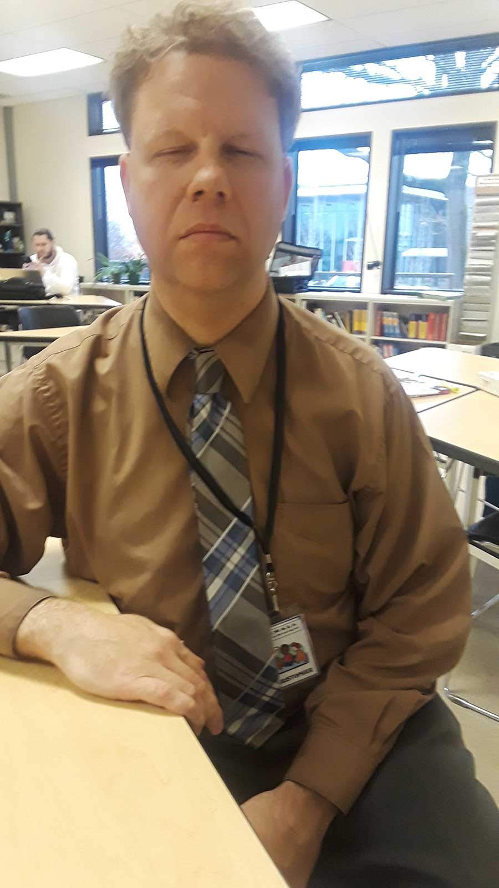
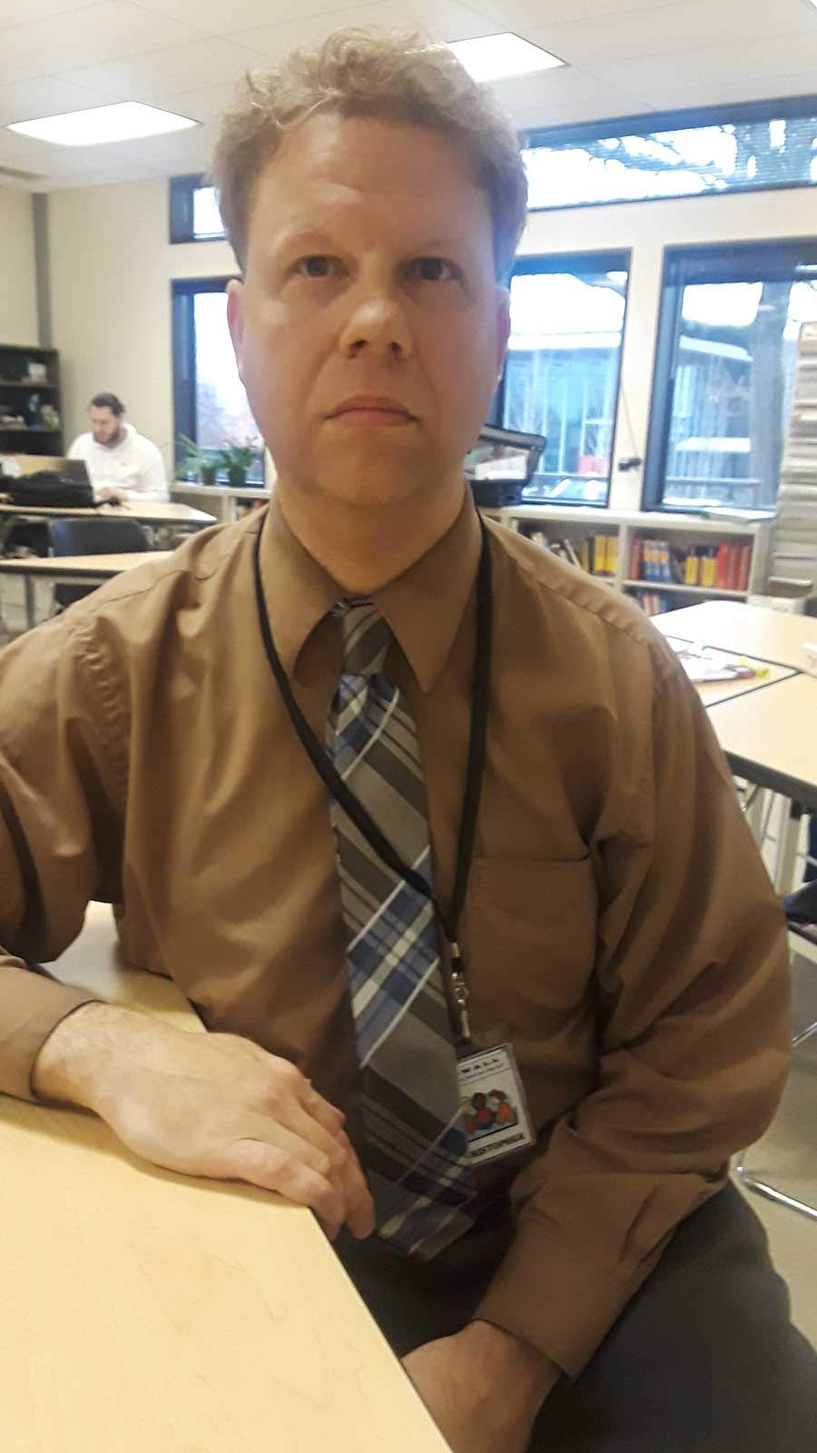
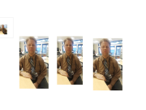

Slide 10
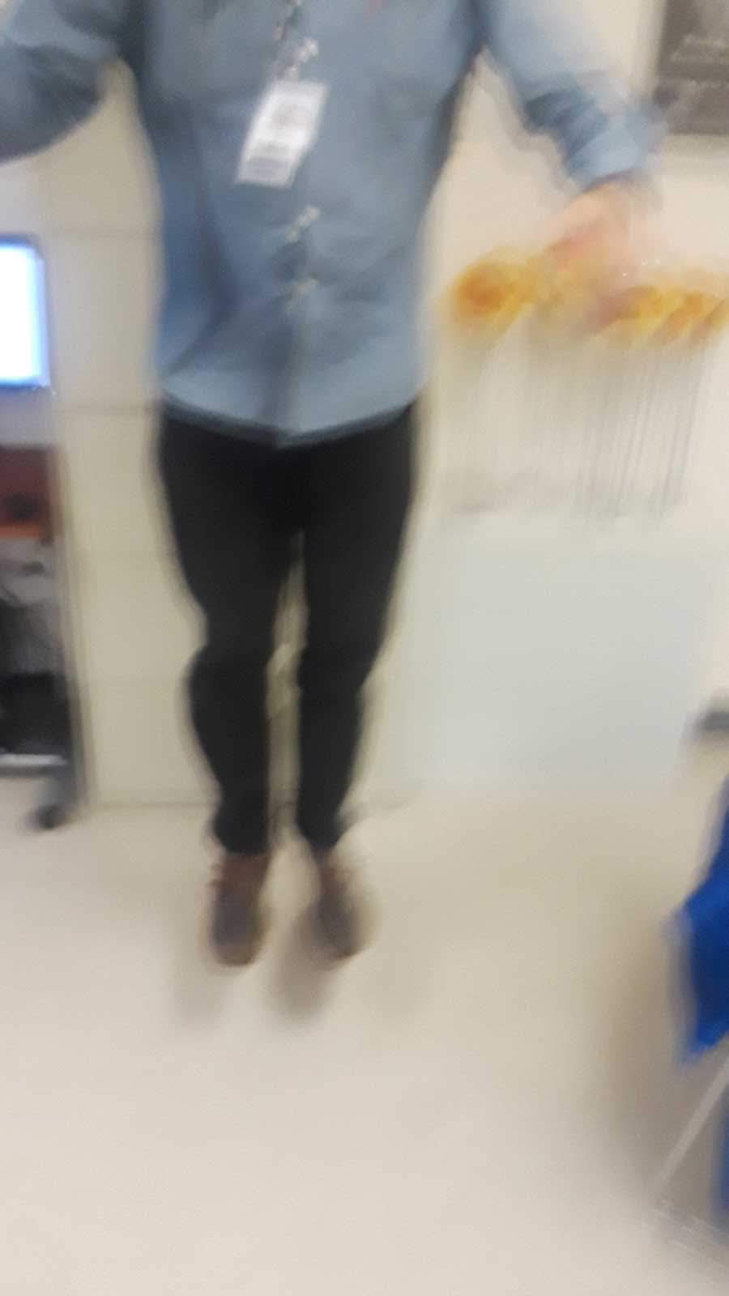
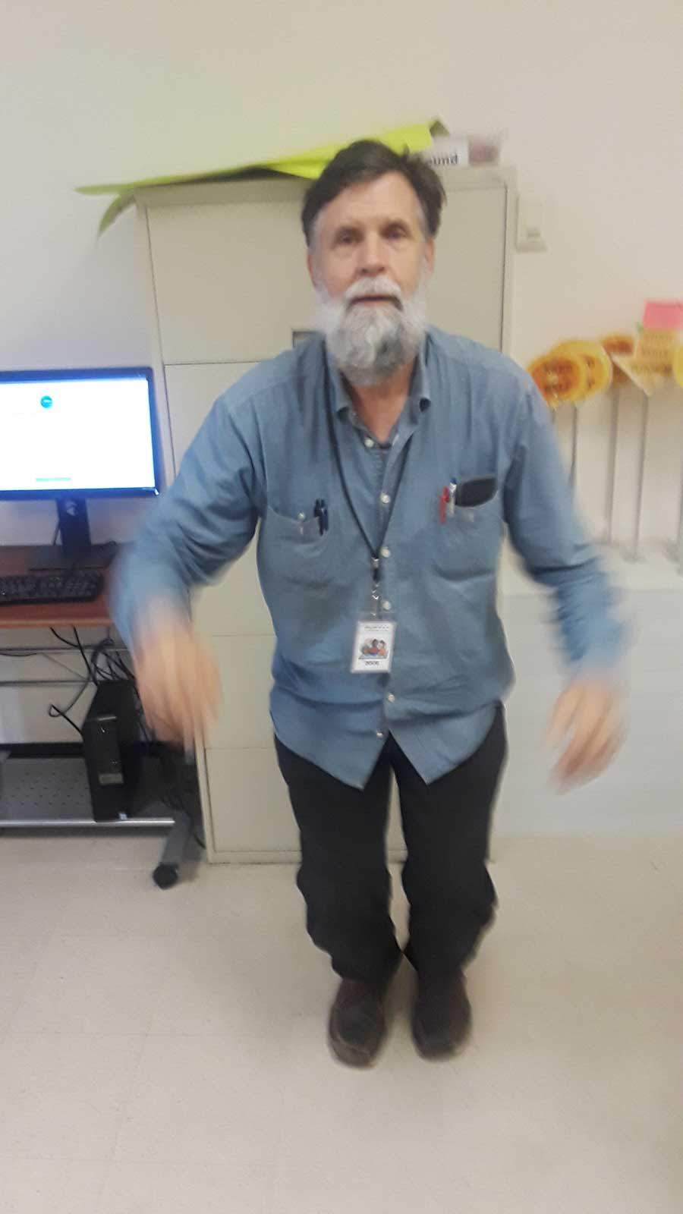

Slide 11
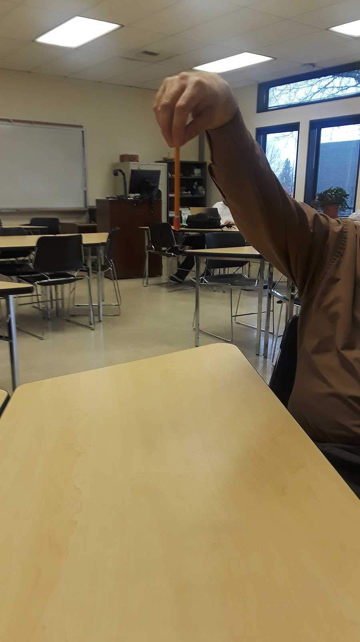
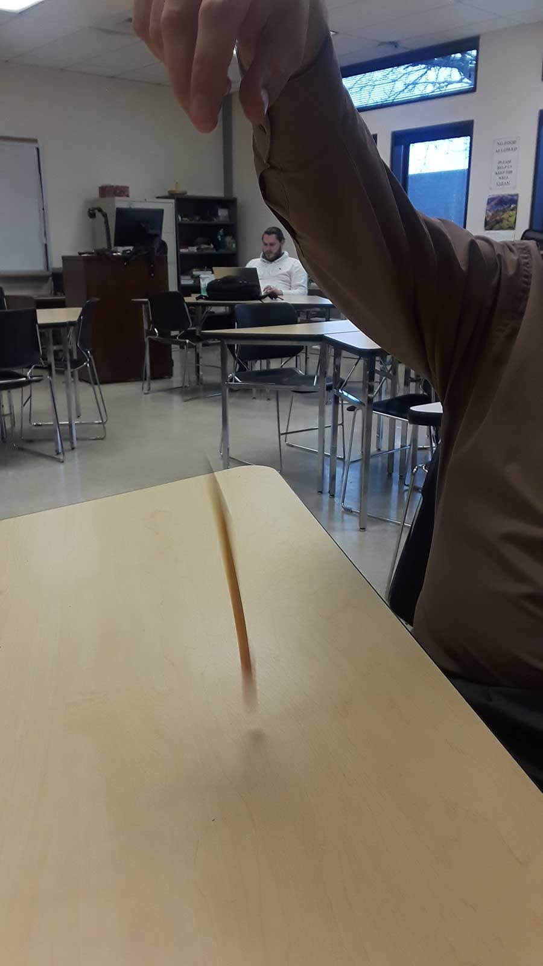

Slide 12
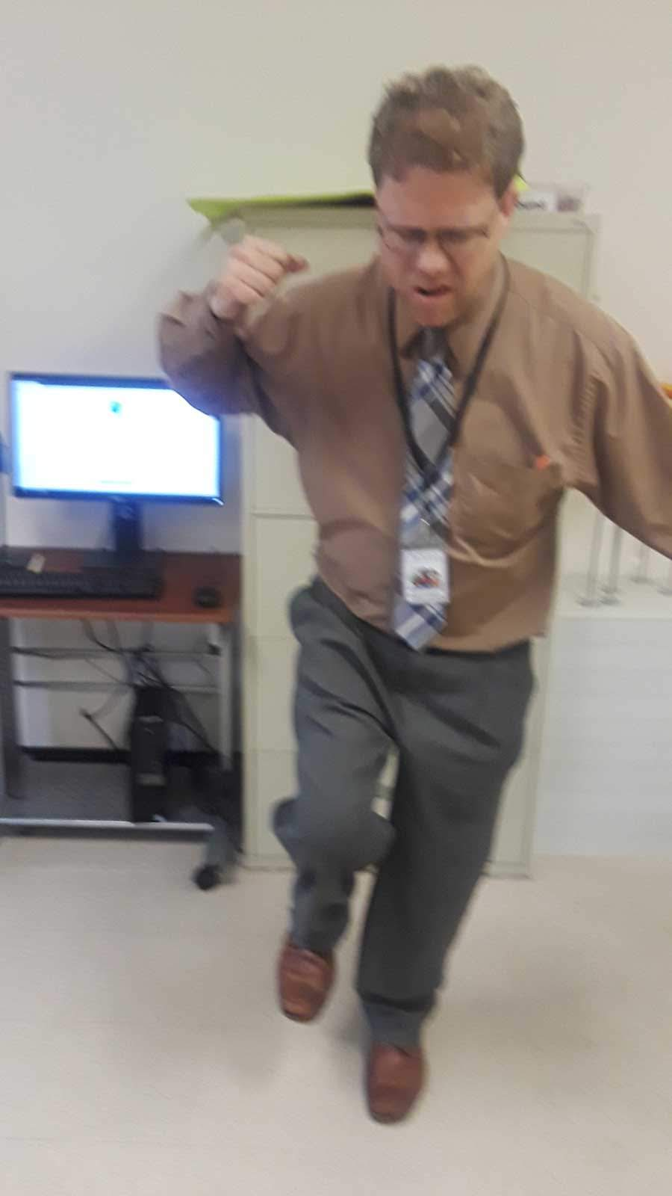
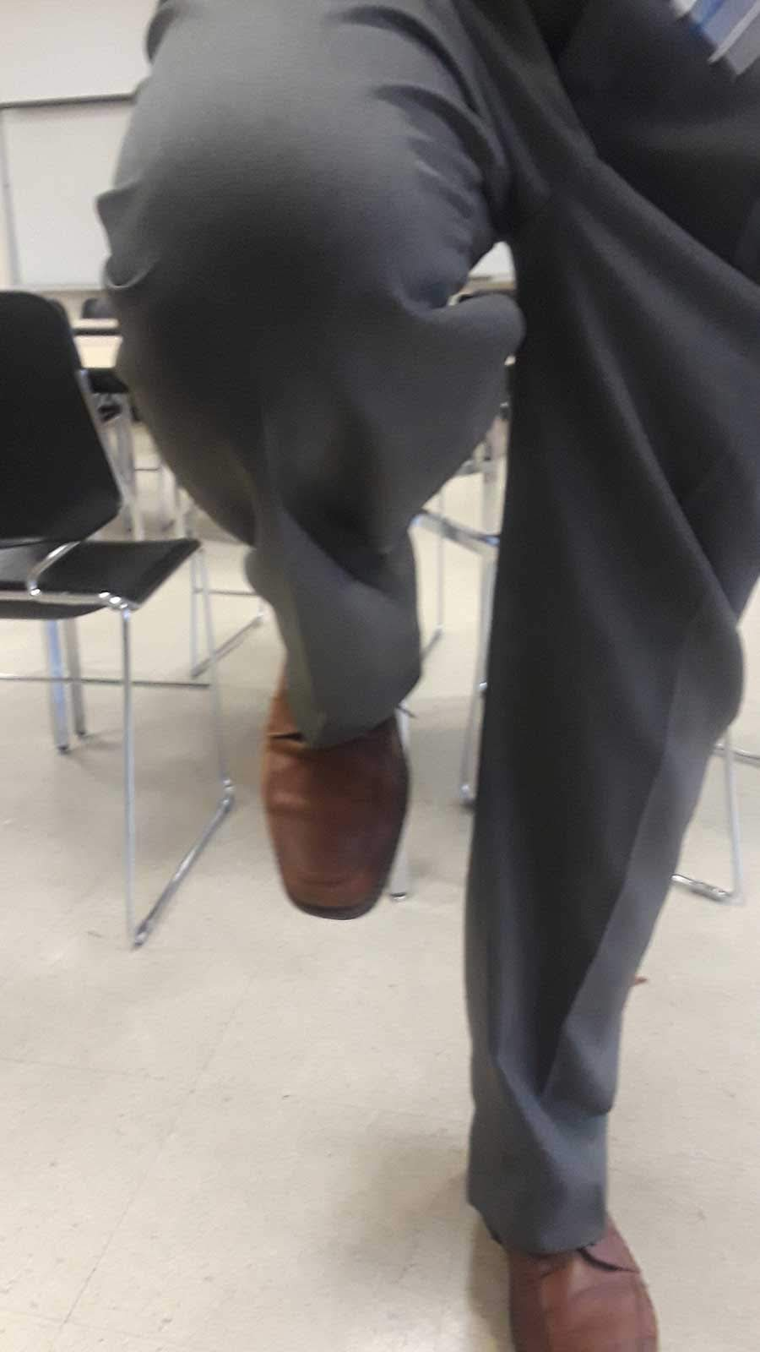

Slide 14
Words:
1. Actions (Verbs)
Examples:
drop, lift
2. Objects (Nouns)
Examples:
Show students (Faces screen)

Slide 16
Seasons

Slide 17
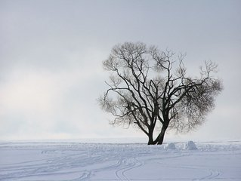
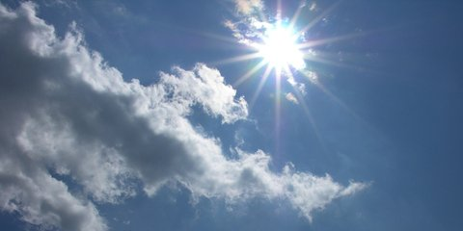
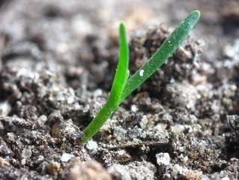
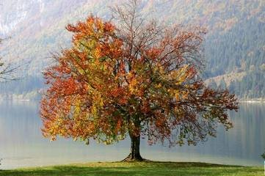
Seasons

Slide 18
Seasons
How many seasons are there?
four

Slide 19
winter

Slide 20
spring

Slide 21
summer

Slide 22
fall

Slide 23
What month is it?

Slide 24
May

Slide 25
What season is May in?

Slide 26
spring

Slide 27
May is in spring.

Slide 28
For months, use “in”.
For seasons, use “in”.
For years , use “in”.
in May
in spring
in 2018

Slide 29
For seasons, use “in”.
Flowers grow ___ spring.
in

Slide 30
For seasons, use “in”.
It snows ___ winter.
in

Slide 31
For days, use “on”.
We have class ___ Saturday.
on

Slide 32
Use “at” for clock time.
I go to sleep ___ 11 p.m.
at

Slide 33
Use “at” for clock time.
Class begins ___ 9 a.m.
at

Slide 34
Use “in” for time of day.
in the morning
in the afternoon
in the evening

Slide 35
Go to website to watch the video:
https://christophersenglishsite.com/Level1/

